Slide 1
GRADE 7 ACCELERATED · UNIT 4 · LESSON 5
Evaluating Expressions with Radicals
MA.8.NSO.1.7
I can evaluate an expression that contains square roots, cube roots and integer exponents.
Grade 7 Accelerated · Unit 4 · Lesson 5 — Evaluating Expressions with Radicals
1

Slide 2
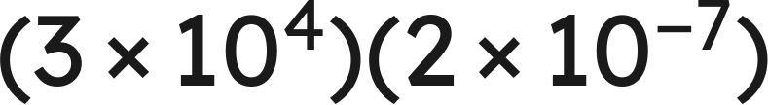
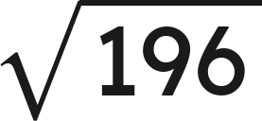

Warm-Up
1. How many significant digits are in 0.0250 ?
2.
3. Find the value:
4. Evaluate:
Grade 7 Accelerated · Unit 4 · Lesson 5 — Evaluating Expressions with Radicals
2

Slide 3
Warm-Up
1. How many significant digits are in 0.0250 ?
3
2.
6 × 10⁻³
3. Find the value:
14
4. Evaluate:
8
Grade 7 Accelerated · Unit 4 · Lesson 5 — Evaluating Expressions with Radicals
3

Slide 4
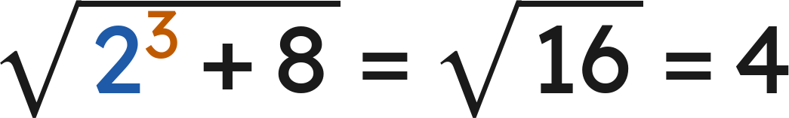
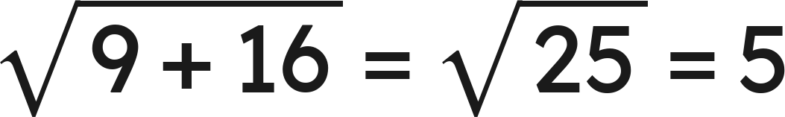

Notes
I. The radical bar is a grouping symbol
, never
Everything under the bar is evaluated before the root is taken.
Grade 7 Accelerated · Unit 4 · Lesson 5 — Evaluating Expressions with Radicals
4

Slide 5
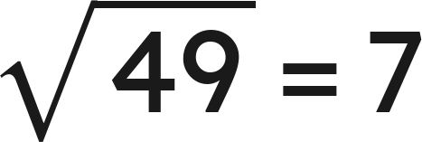
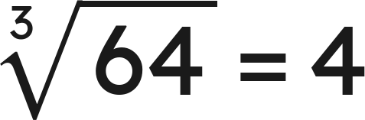
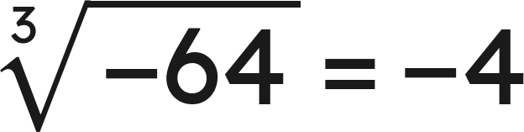
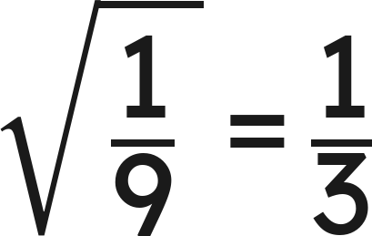
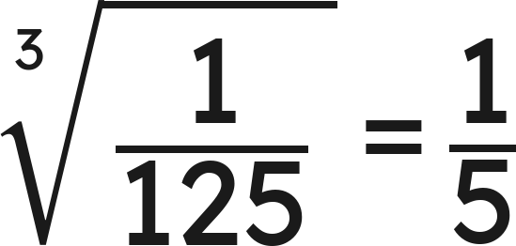
Notes
II. Square roots and cube roots are not the same shape
An odd root keeps the sign of its radicand. A square root sign never gives a negative value.
Grade 7 Accelerated · Unit 4 · Lesson 5 — Evaluating Expressions with Radicals
5

Slide 6
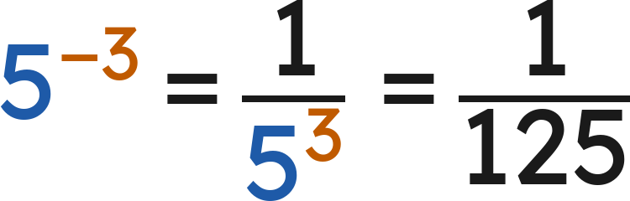
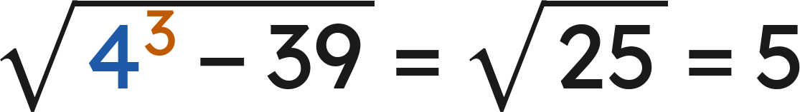
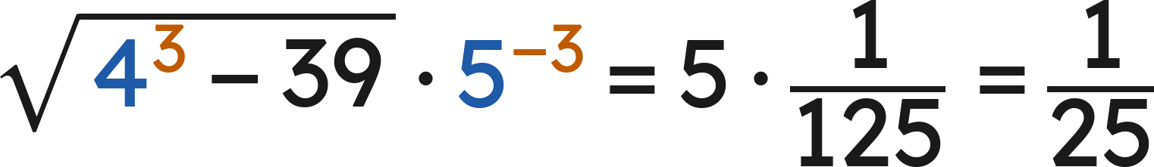
Notes
III. Radicals alongside exponents
Finish each piece — the radical, the power — and only then put them together.
Grade 7 Accelerated · Unit 4 · Lesson 5 — Evaluating Expressions with Radicals
6

Slide 7
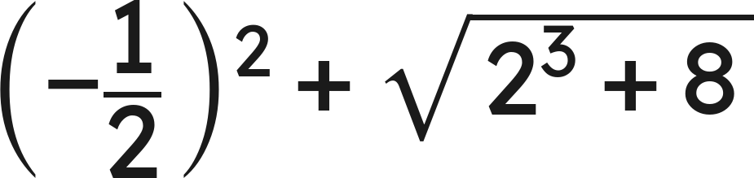
Example 1
Evaluate.
Grade 7 Accelerated · Unit 4 · Lesson 5 — Evaluating Expressions with Radicals
7

Slide 8
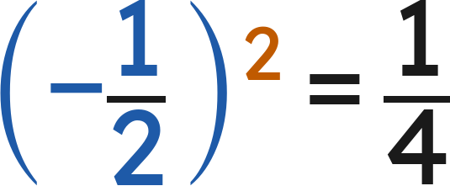
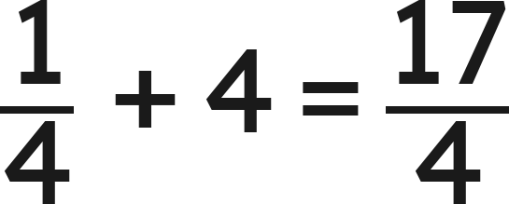
Example 1
Answer: 17/4
Grade 7 Accelerated · Unit 4 · Lesson 5 — Evaluating Expressions with Radicals
8

Slide 9
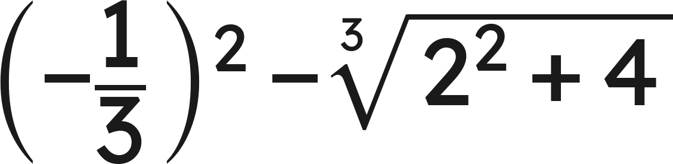
Your Turn
Evaluate.
Grade 7 Accelerated · Unit 4 · Lesson 5 — Evaluating Expressions with Radicals
9

Slide 10
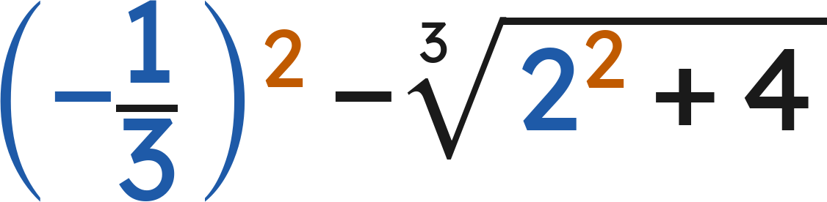
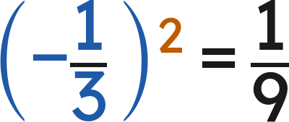
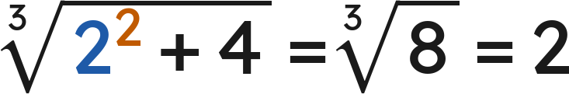
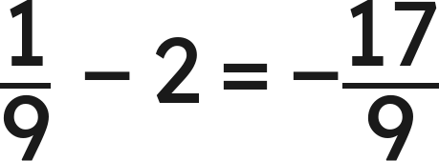
Your Turn
Evaluate.
Answer: −17/9
Grade 7 Accelerated · Unit 4 · Lesson 5 — Evaluating Expressions with Radicals
10

Slide 11
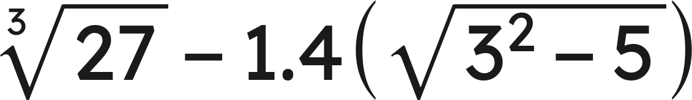
Example 2
Evaluate.
Grade 7 Accelerated · Unit 4 · Lesson 5 — Evaluating Expressions with Radicals
11

Slide 12
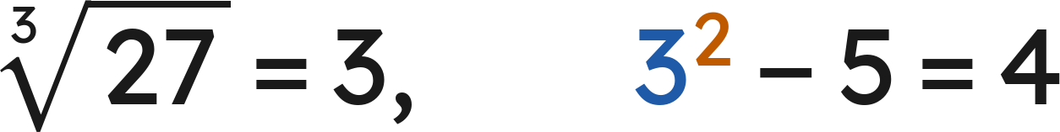
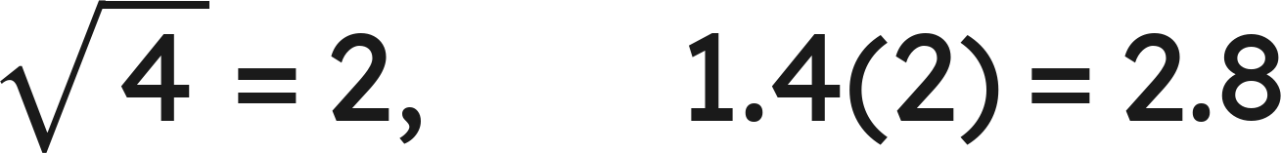

Example 2
Answer: 0.2
Grade 7 Accelerated · Unit 4 · Lesson 5 — Evaluating Expressions with Radicals
12

Slide 13
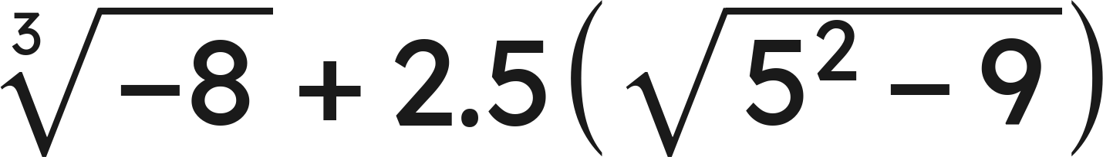
Your Turn
Evaluate.
Grade 7 Accelerated · Unit 4 · Lesson 5 — Evaluating Expressions with Radicals
13

Slide 14
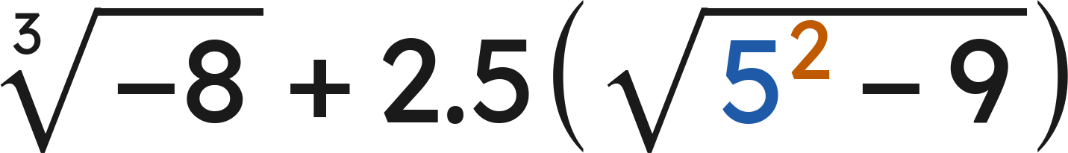
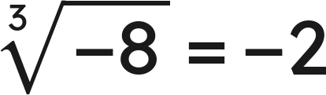
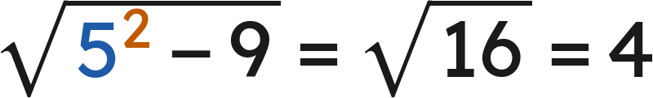
Your Turn
Evaluate.
Answer: 8
Grade 7 Accelerated · Unit 4 · Lesson 5 — Evaluating Expressions with Radicals
14

Slide 15
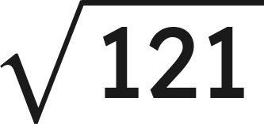
Whiteboards · Question 1 of 9
Answer it.
Grade 7 Accelerated · Unit 4 · Lesson 5 — Evaluating Expressions with Radicals
15

Slide 16
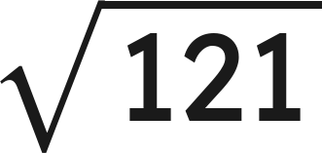

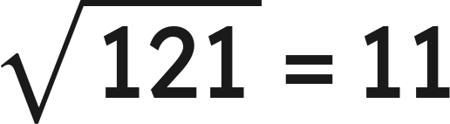
Whiteboards · Question 1 of 9
, so
Answer: 11
Grade 7 Accelerated · Unit 4 · Lesson 5 — Evaluating Expressions with Radicals
16

Slide 17
Whiteboards · Question 2 of 9
A square patio has an area of 169 square feet.
Fencing for it costs 12 dollars a foot.
How long is one side of the patio?
Answer it.
Grade 7 Accelerated · Unit 4 · Lesson 5 — Evaluating Expressions with Radicals
17

Slide 18

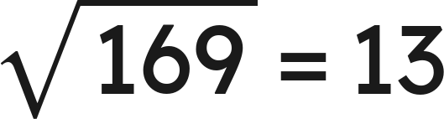
Whiteboards · Question 2 of 9
A square patio has an area of 169 square feet.
Fencing for it costs 12 dollars a foot.
How long is one side of the patio?
Side × side = 169
, so
Answer: 13 feet
Grade 7 Accelerated · Unit 4 · Lesson 5 — Evaluating Expressions with Radicals
18

Slide 19
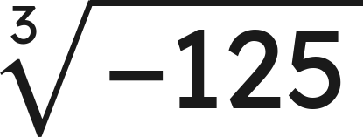
Whiteboards · Question 3 of 9
Answer it.
Grade 7 Accelerated · Unit 4 · Lesson 5 — Evaluating Expressions with Radicals
19

Slide 20
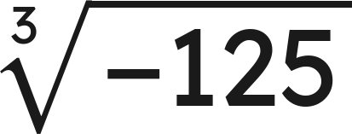
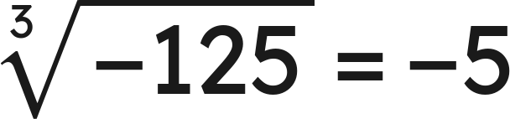
Whiteboards · Question 3 of 9
, so
Answer: −5
Grade 7 Accelerated · Unit 4 · Lesson 5 — Evaluating Expressions with Radicals
20

Slide 21
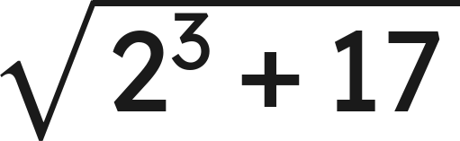
Whiteboards · Question 4 of 9
Answer it.
Grade 7 Accelerated · Unit 4 · Lesson 5 — Evaluating Expressions with Radicals
21

Slide 22
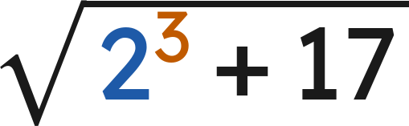

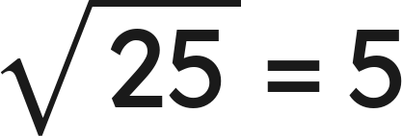
Whiteboards · Question 4 of 9
Under the bar first:
Answer: 5
Grade 7 Accelerated · Unit 4 · Lesson 5 — Evaluating Expressions with Radicals
22

Slide 23
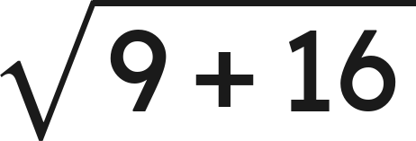
Whiteboards · Question 5 of 9
Which is the value?
A. 7
B. 25
C. 12.5
D. 5
Answer it.
Grade 7 Accelerated · Unit 4 · Lesson 5 — Evaluating Expressions with Radicals
23

Slide 24
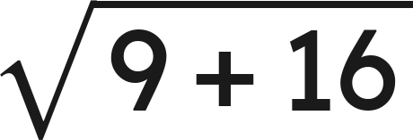

Whiteboards · Question 5 of 9
Which is the value?
Under the bar first:
Answer: D — 5
Grade 7 Accelerated · Unit 4 · Lesson 5 — Evaluating Expressions with Radicals
24

Slide 25
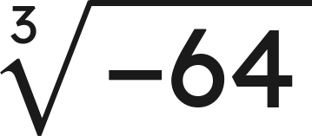
Whiteboards · Question 6 of 9
Which is the value?
A. −4
B. not a real number
C. −8
D. 4
Answer it.
Grade 7 Accelerated · Unit 4 · Lesson 5 — Evaluating Expressions with Radicals
25

Slide 26
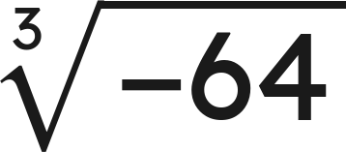
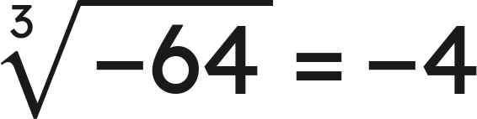
Whiteboards · Question 6 of 9
Which is the value?
, so
Answer: A — −4
Grade 7 Accelerated · Unit 4 · Lesson 5 — Evaluating Expressions with Radicals
26

Slide 27
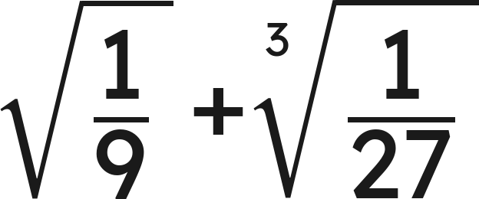
Whiteboards · Question 7 of 9
Answer it.
Grade 7 Accelerated · Unit 4 · Lesson 5 — Evaluating Expressions with Radicals
27

Slide 28
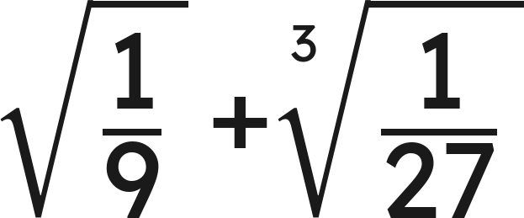
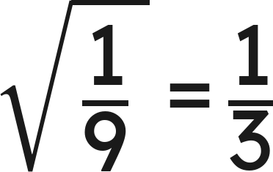
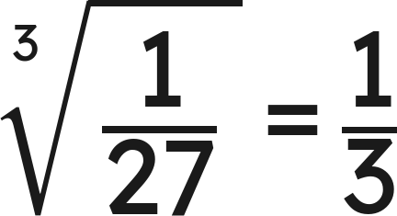
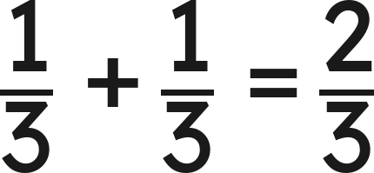
Whiteboards · Question 7 of 9
and
Answer: 2/3
Grade 7 Accelerated · Unit 4 · Lesson 5 — Evaluating Expressions with Radicals
28

Slide 29
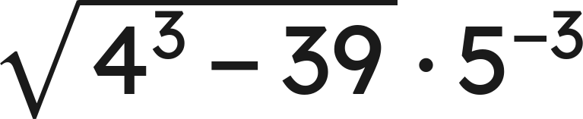
Whiteboards · Question 8 of 9
Answer it.
Grade 7 Accelerated · Unit 4 · Lesson 5 — Evaluating Expressions with Radicals
29

Slide 30
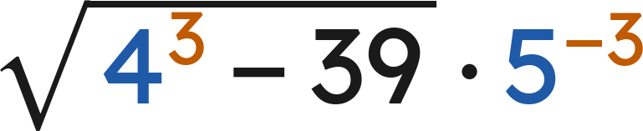
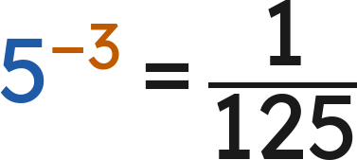

Whiteboards · Question 8 of 9
Answer: 1/25
Grade 7 Accelerated · Unit 4 · Lesson 5 — Evaluating Expressions with Radicals
30

Slide 31

Whiteboards · Question 9 of 9
Simon says that
is not a real number,
because you cannot take the root of a negative.
Explain why he is wrong, and give the value.
Write your answer in sentences.
Grade 7 Accelerated · Unit 4 · Lesson 5 — Evaluating Expressions with Radicals
31

Slide 32


Whiteboards · Question 9 of 9
Simon says that
is not a real number,
because you cannot take the root of a negative.
Explain why he is wrong, and give the value.
A cube root can be negative: three negatives multiply to a negative.
, so
Answer: −3
Grade 7 Accelerated · Unit 4 · Lesson 5 — Evaluating Expressions with Radicals
32

Slide 33






Independent Set
1.
2.
3.
4.
5.
6.
Grade 7 Accelerated · Unit 4 · Lesson 5 — Evaluating Expressions with Radicals
33

Slide 34
IXL
1.
Open IXL and start today's skills.
2.
Work on paper where the question needs work. The answer box does not show it.
3.
Every skill listed is required, to a SmartScore of 67. This skill continues tomorrow: one assignment, due at the start of the class after 4.06.
Today's skills — all required
Evaluate radical expressions — D8J
Grade 7 Accelerated · Unit 4 · Lesson 5 — Evaluating Expressions with Radicals
34

